Slide 1
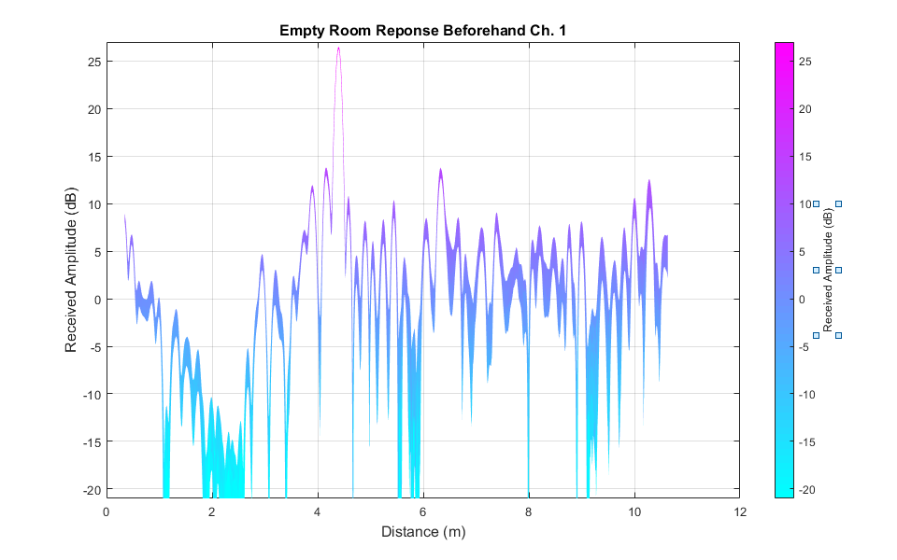
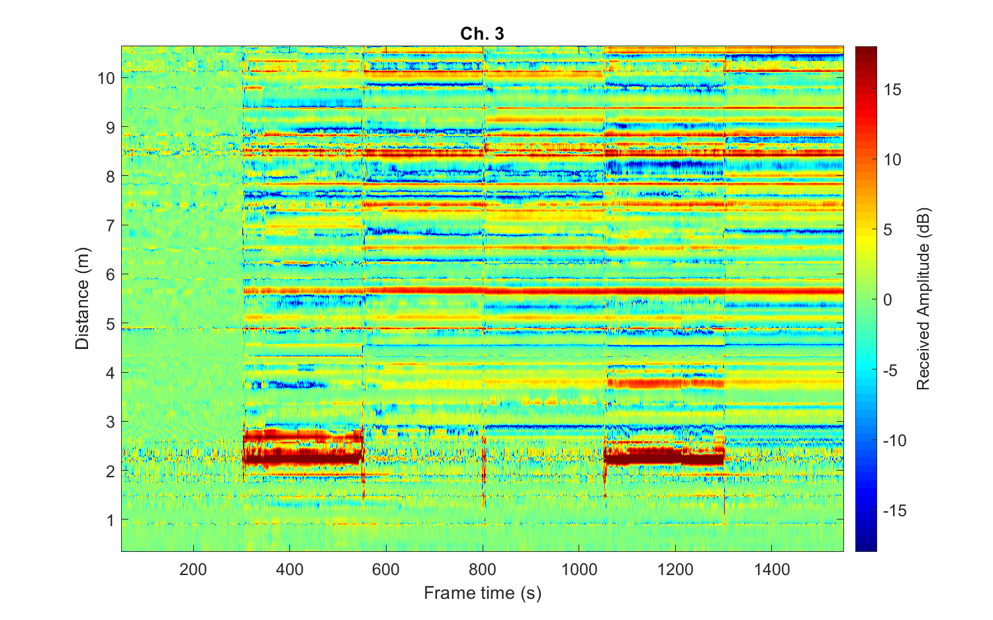
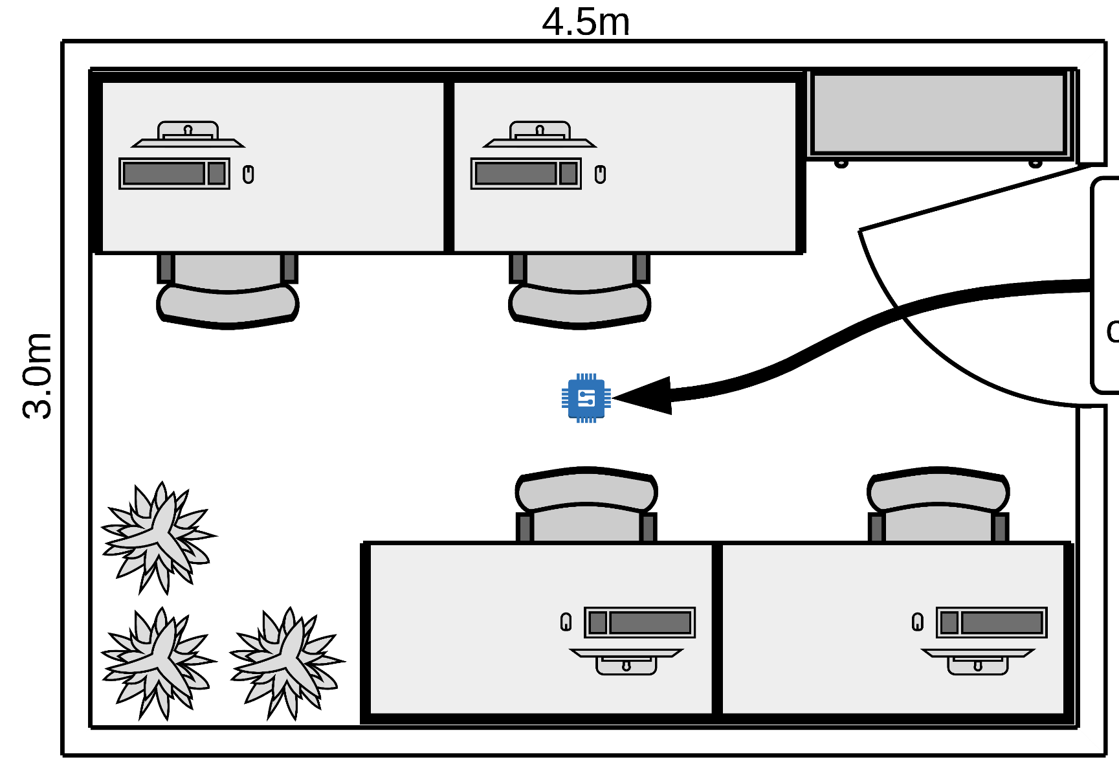
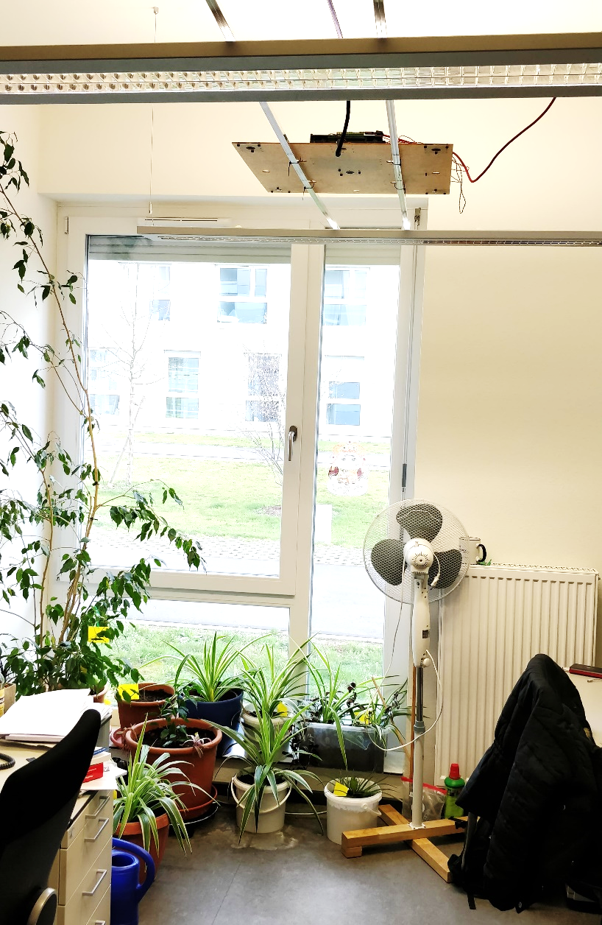



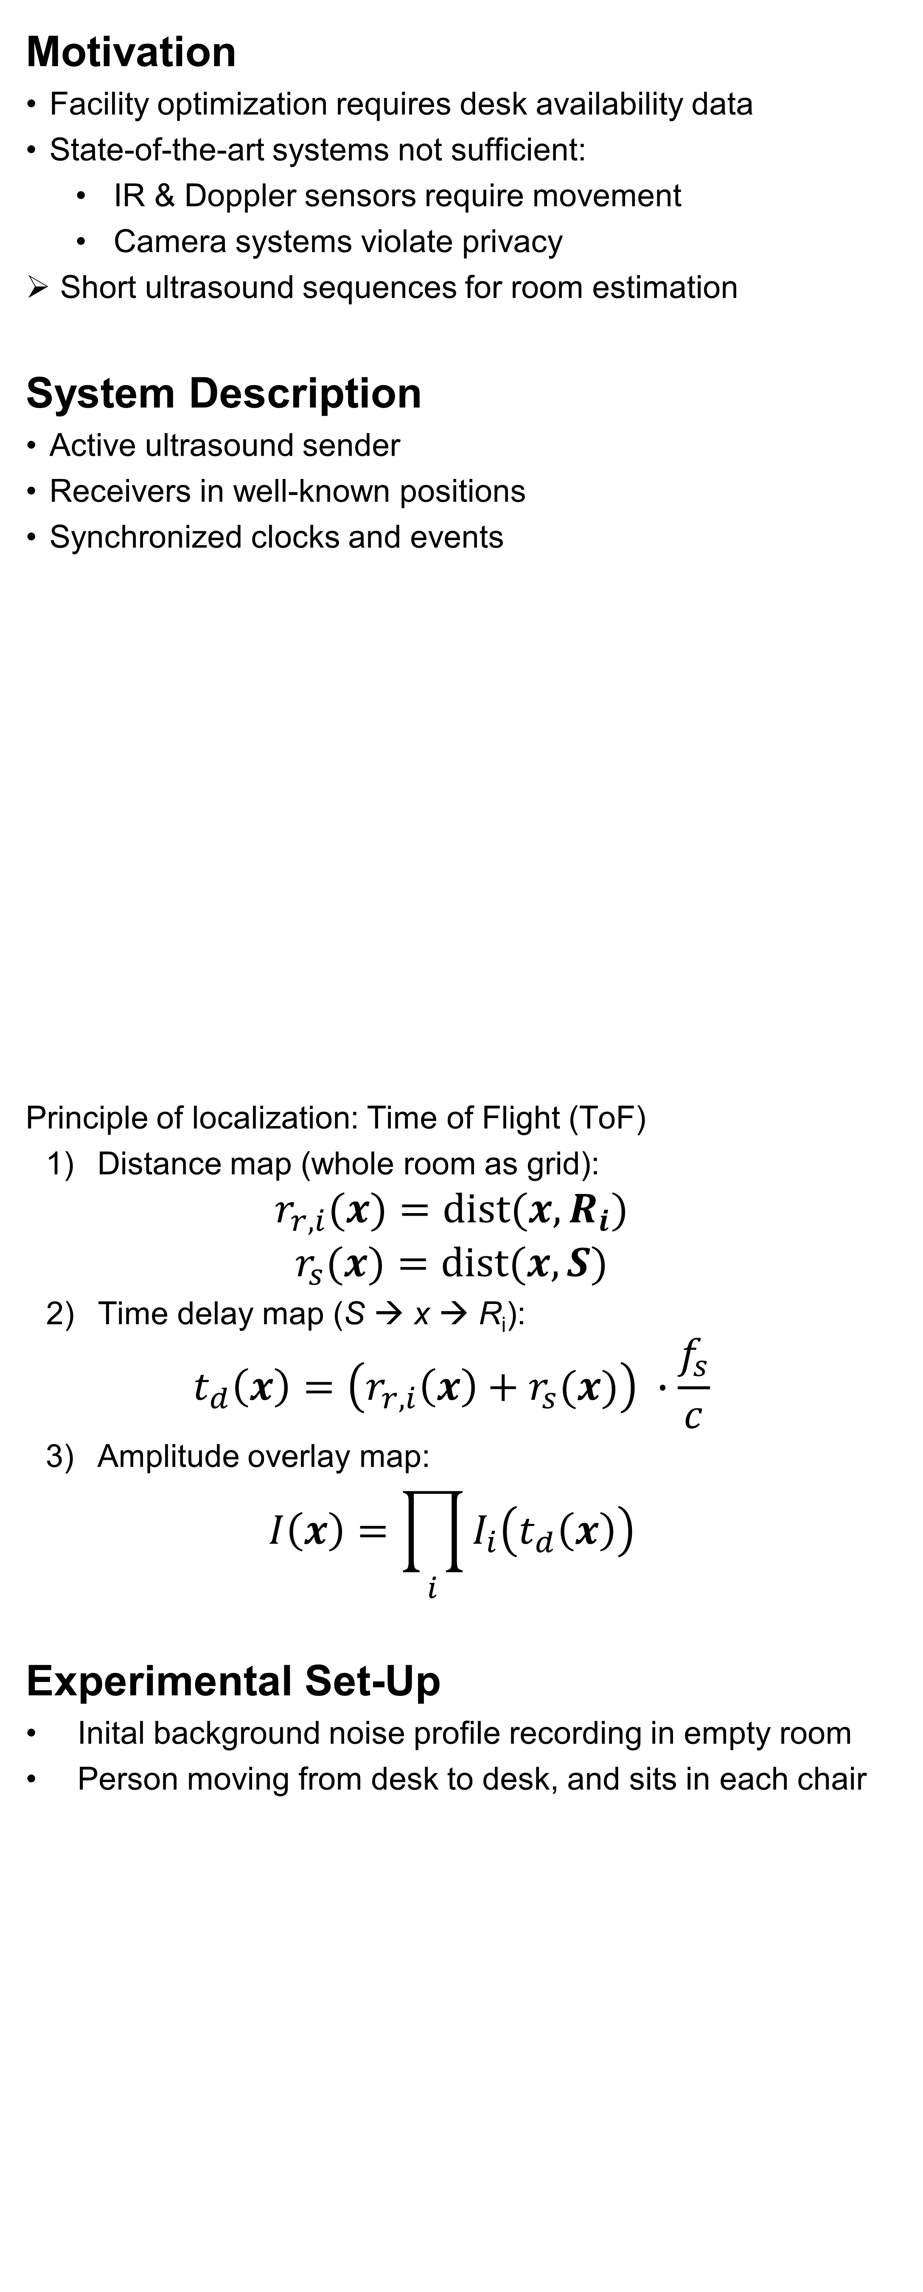
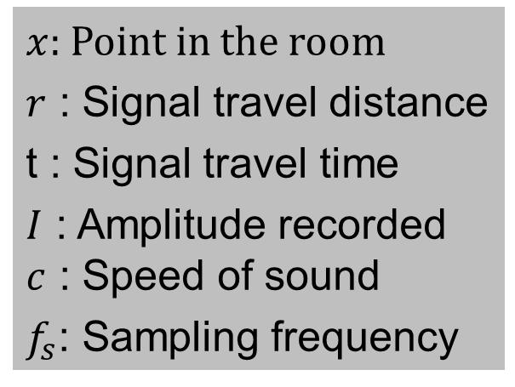
Indoor SONAR system for desk availability monitoring
A. Saphala¹⁾, D.J. Schott¹⁾, V.C. Rao¹⁾, F. Höflinger^{1,3)}, J. Wendeberg^{2,3)}, C. Schindelhauer²⁾ , L.M. Reindl¹⁾
¹⁾ Department of Microsystems Engineering (IMTEK), University of Freiburg, Germany
²⁾ Department of Computer Science (IIF), University of Freiburg, Germany
³⁾ Telocate GmbH, Freiburg im Breisgau, Germany
Motivation
Facility optimization requires desk availability data
State-of-the-art systems not sufficient:
IR & Doppler sensors require movement
Camera systems violate privacy
Short ultrasound sequences for room estimation
System Description
Active ultrasound sender
Receivers in well-known positions
Synchronized clocks and events
Principle of localization: Time of Flight (ToF)
Distance map (whole room as grid):
$$r_{r,i}(x)=\text{dist}(x, R_{i})$$
$$r_{s}(x)=\text{dist}(x, S)$$
Time delay map (S → x → R_{i}):
$$t_{d}\left(x\right)=\left(r_{r,i}\left(x\right)+r_{s}(x)\right) ∙\frac{f_{s}}{c}$$
Amplitude overlay map:
$$I\left(x\right)=\prod_{i}{I_{i}\left(t_{d}\left(x\right)\right)}$$
Experimental Set-Up
Inital background noise profile recording in empty room
Person moving from desk to desk, and sits in each chair
Results
Outlook
Compensate path loss due to spreading
Diffusor structure (e.g. inverse horn antenna)
Portable set-up (no commercial audio interface, Rpi based)
Real-time availability indication
Optimize Directivity of Transducers
Acknowledgements
We appreciate the technical support by Telocate GmbH and their patience in the grindingly permanent presence of our test sounds, driving everyone to the brink of madness.
Ground Reflection
Sender S
Receivers R_{i}
Head H
Fig. 3: Averaged room response as measured by the receiver  as determined over the first 300 frames. It serves as a baseline, which is subtracted from the later recordings to remove static multipaths, as they occur at the round and the walls. The strong line-of-sight signal at distance 0 is deliberately not shown.
Occupied Desk
Free Desk
Fig. 1: Room set-up illustrating the working principle of the system. The signal of the synchronized sender is recorded and analyzed.
Grayed: Multipath dominated region
$x$: Point in the room
$r$ : Signal travel distance
t : Signal travel time
$I$ : Amplitude recorded $c$ : Speed of sound
$f_{s}$: Sampling frequency
EMPTY ROOM: BEFORE EXPERIMENT
EMPTY ROOM: AFTERWARDS
A
B
C
D
Fig. 6: Sonogram of the experimental office with changing desk occupancy. The presence of Persons leads to reflections and shadowing that deviate from the empty room response. For the desks indicated by the letters see Fig. 2(left).


C
A
●
S
❍
❍

S
●

B
D
C
Lamps
D
Fig. 2: Top view schematic of the experimental office (left), and a picture of the installation (right). The letters A to D indicate desk positions, the circled numbers 1 to 4 the receivers, the circled s the sender.

